Slide 1
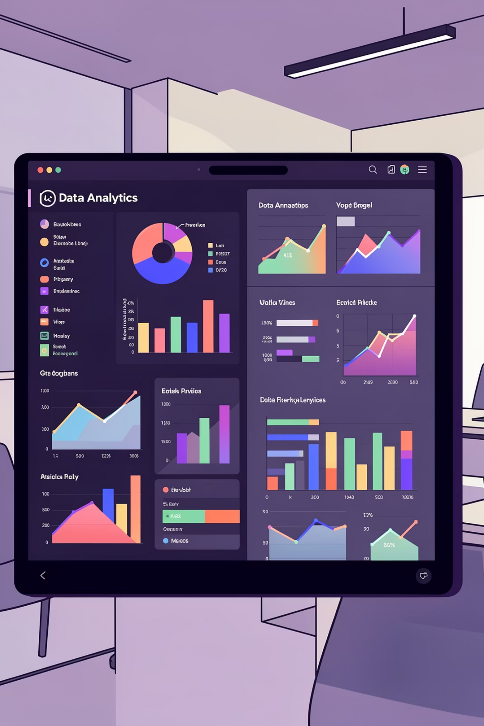
Customer Behavior Analysis Report
Analyzing 3,900 customer transactions to unlock strategic insights for marketing optimization and revenue growth

Slide 2

DATASET OVERVIEW
The Data Foundation
3.9K
18
37
Customer Records
Features
Missing Values
Transaction data analyzed
Data attributes tracked
In Review Rating column
Data Categories
Customer Demographics: Age, Gender, Location
Product Details: Item, Category, Size, Color, Season
Transaction Data: Purchase Amount, Payment Method, Shipping
Behavior Metrics: Previous Purchases, Subscription Status, Review Rating

Slide 3

DATA PROCESSING
Exploratory Data Analysis
01
02
Initial Exploration
Missing Value Treatment
Dataset profiling with info() and describe() functions
Filled Review Rating gaps using category-specific medians
03
04
Feature Engineering
Data Cleanup
Created age groups and purchase frequency metrics
Removed redundant promo_code_used column

Slide 4

KEY METRICS
Statistical Snapshot
Average Purchase
Customer Age
Review Rating
$59.76
44 years
3.75/5.0
Previous Purchases
25 median
Purchase Range: $15-$250 | Std Dev: $45.32 | Customer LTV: $1,847 (loyal)

Slide 5

68% of revenue from male customers
Male: $58.48/customer
Female: $62.66/customer
Opportunity: +$94K if female reaches parity
Male
Female

Slide 6
Product Performance Insights
Clothing
Accessories
169-171 orders
161-171 orders
35% revenue
28% revenue
⭐4.2
⭐4.0
Footwear
Other Categories
150-160 orders
Order data varies
22% revenue
15% revenue
⭐3.9
⭐3.86 (Gloves)

Slide 7
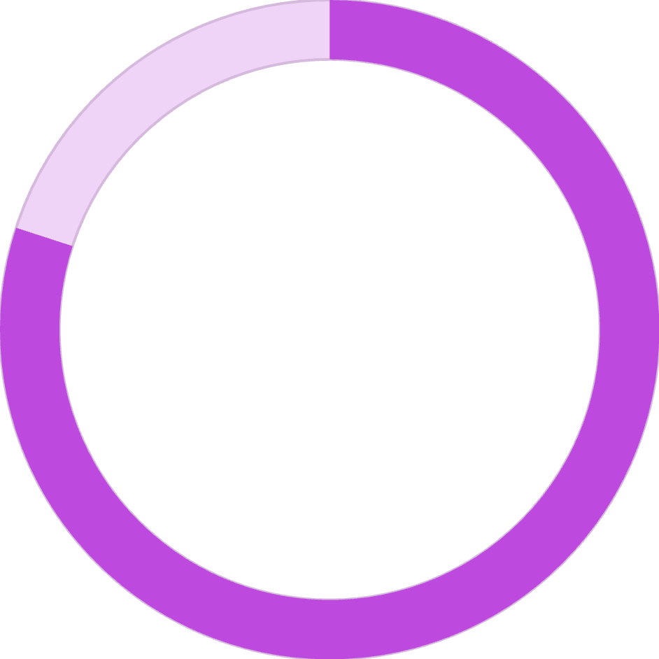
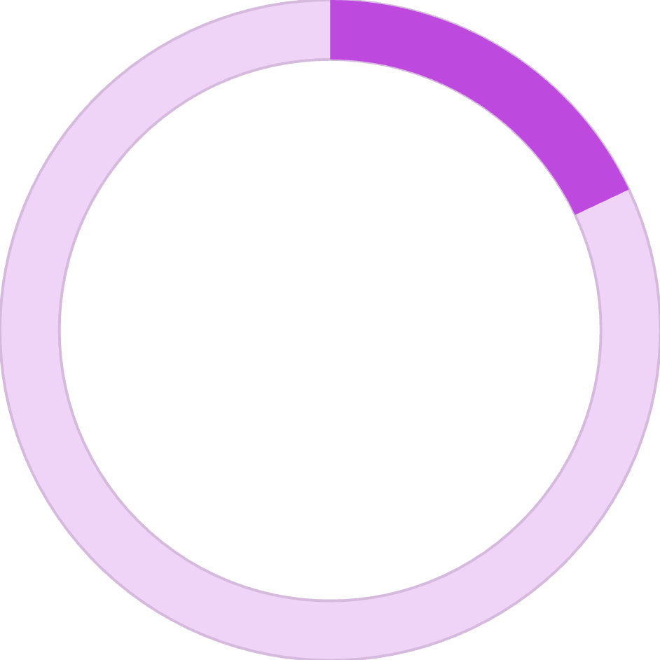


Customer Segmentation Breakdown
80%
18%
2%
Loyal (3,116)
Returning (701)
New (83)
80% of customers = 92% of revenue (concentration risk)

Slide 8
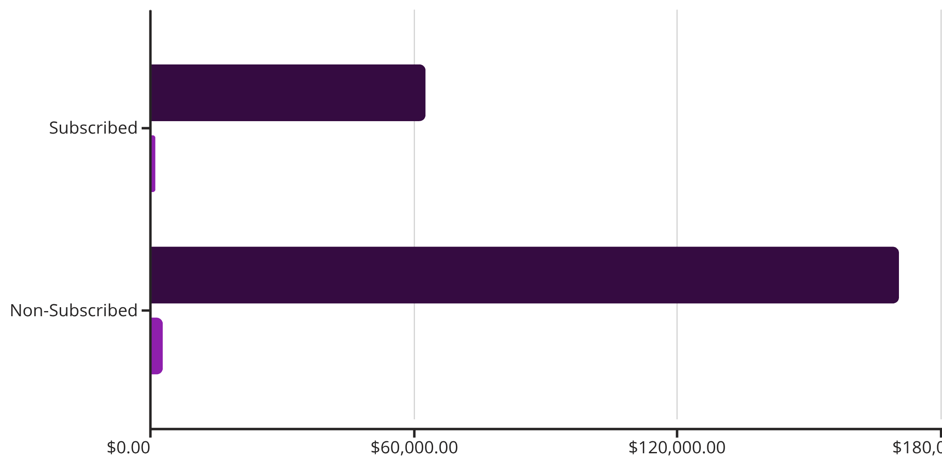
DISCOUNT ANALYSIS
Subscription & Discount Patterns
Non-Subscribers
Drive 73% of revenue
Promo Code Use
43% of customers
Discount Margin
18% (vs 35% full-price)
Revenue
Customers
Recommendation: Shift discount strategy to focus on margin preservation and optimized new subscriber acquisition, rather than blanket discounts, especially on low-margin categories.

Slide 9

STRATEGIC RECOMMENDATIONS
Business Recommendations
Optimize Subscriptions
Reward Loyalty
Refine Discounts
Reduce churn by 5%
Potential +$10K monthly profit
Potential +$18K monthly revenue
Target Female Segment
Generate +$20K additional monthly revenue

Slide 10





Next Steps
Implement Loyalty Program
Test Subscription Tiers
Q1 2024 launch
A/B testing phase
Female-Focused Campaigns
Monitor & Optimize
Personalized outreach
Continuous improvement

